Slide 1

Differentiable Particle Filters:
End-to-End Learning with Algorithmic Priors
Presented By Charles Nimo, Kulin Shah, Alex Zuzow
Paper:
Differentiable Particle Filters: End-to-End Learning with Algorithmic Priors
Rico Jonschkowski, Divyam Rastogi, and Oliver Brock
arxiv.org/abs/1805.11122

Slide 2
Goal and Motivation
Goal: Run differentiable particle filter on few maps in Gates-Dell Complex.
Advantages of End-to-End learning
Utilizes algorithmic priors from particle filters
Requires 87% less training data for the same error rate as LSTM
Notes:
So our project is to explore applying the differentiable particle filter on the car to navigate different floors of gdc
there are three main reasons why differentiable particle filters are preferable to other methods
The most obvious reason is that it gains the advantages of end-to-end learning, this allows us to optimize all parts of the model for end-to-end performance instead of each individual component.
Another key feature of differentiable particle filters is that they gain some interpretability due to algorithmic priors while also providing a performance boost.
Lastly in comparison to LSTM, differentiable particle filters reduce the error rate by ∼80% or require 87% less training data for the same error rate

Slide 3
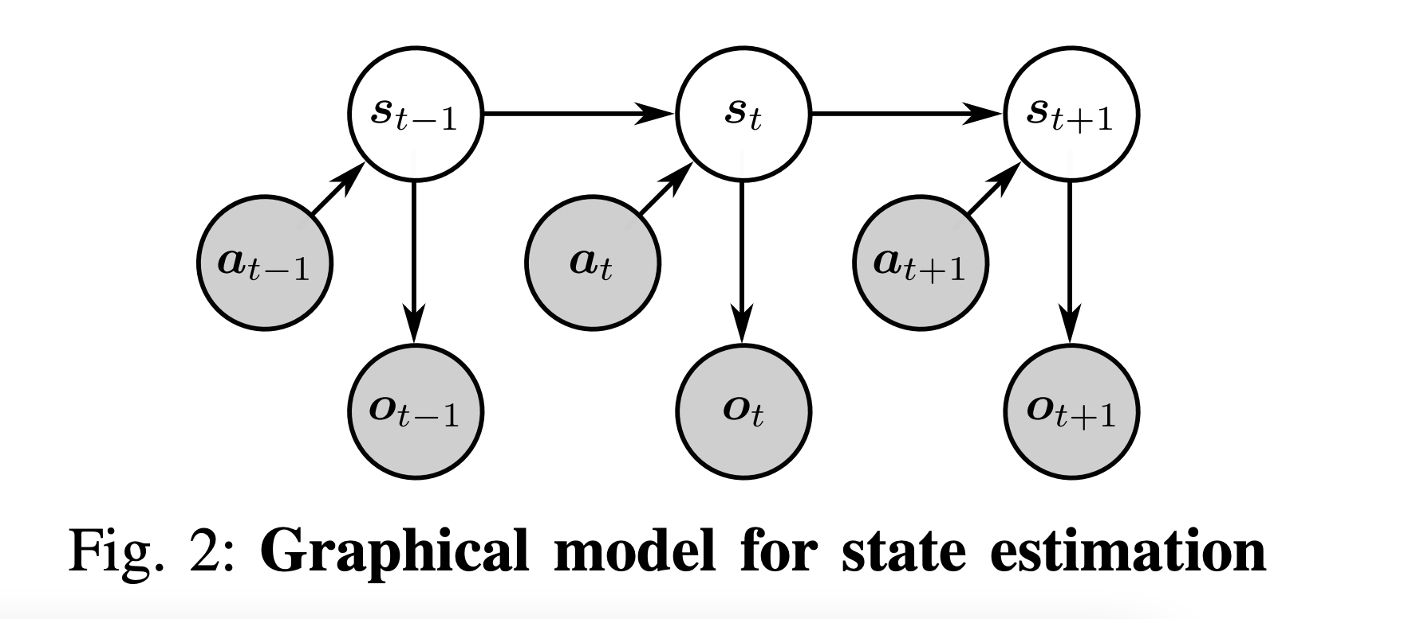
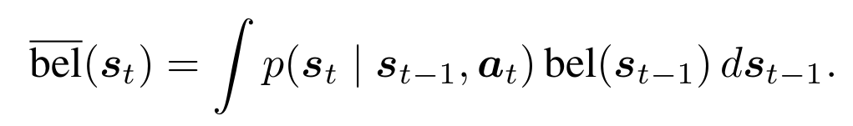
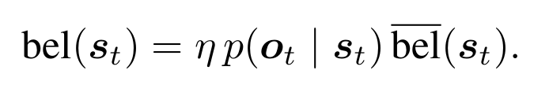
Particle Filter
Motion Model
Observation Likelihood Model
Notes:
Originally in class when we were covering the particle filter algorithm we learned that
The prediction step is based on the motion model which defines how likely the robot is to enter a state if it performs an action. Using the motion model, this step computes the predicted belief by summing over all previous states which could have led to the current state.
The update step uses the measurement model , which defines the likelihood of an observation given a state .this step updates the belief using Bayes’ rule (with normalization η)

Slide 4
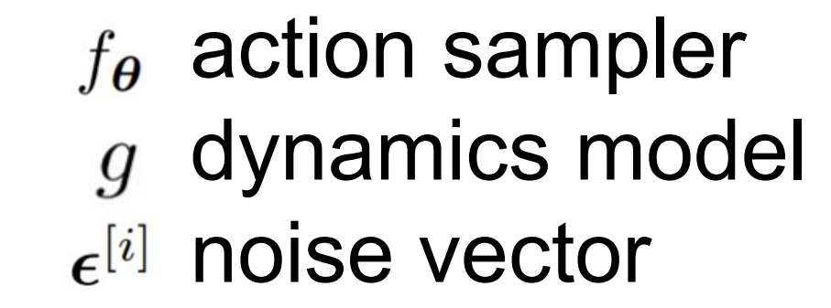
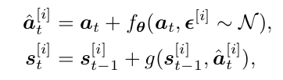
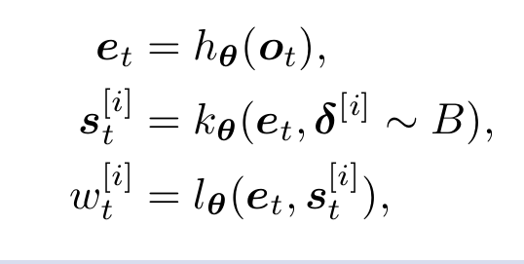
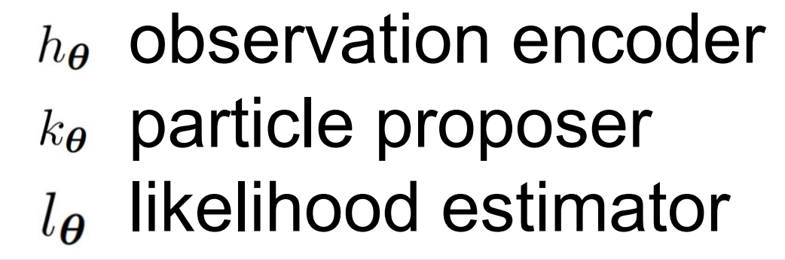
Differentiable Particle Filters
Motion Model
Observation Likelihood Model
Notes:
The motion model in differentiable particle filter is divided into two steps, first a noise vector epsilon which is created using the reparameterization trick and the noise vector is sent to an action sampler f which proposes an action for each particle, then these particles are sent to the dynamics model g which predicts the particle at next time.
The observation likelihood model consists of three components, a shared observation encoder h, a particle proposer k, and a an observation likelihood estimator l.
hθ, kθ, and lθ are feedforward networks and ; delta is a dropout vector used as a source of randomness for sampling different particles from the same encoding.

Slide 5
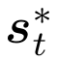
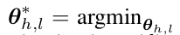
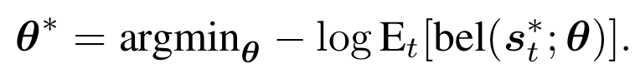
Training Differentiable Particle Filter
Individual learning of motion model
Known dynamic model
Action sampler maximizes the data likelihood
Individual learning of observation likelihood model
Particle proposer maximizes the Gaussian mixture at
Observation encoder and Likelihood estimator maximizes the likelihood of observations in true state and minimizing likelihood in other states
3. End-to-end learning
Notes:
Training of the differentiable particle filter is mainly divided in 3 parts.
First, it trains individual models and then, finetunes all models using end-to-end training. Individual training of models is similar to supervised learning training. Observations o, actions a and states s are provided in the input data and we know dynamic model g so individual training of motion model tries to maximize the data likelihood with respect to correct next state.
In observation likelihood model, particle proposer k is trained by generating sample from observation and maximizing the Gaussian mixture likelihood at s whereas observation encoder h and likelihood estimator maximizes the likelihood of observations in true state and minimizing likelihood in other states.
In end to end training, DPF maximizes the belief at all true states along the sequence.

Slide 6
Limitations
Differentiable Particle Filter implements resampling by stochastic universal sampling, which is not differentiable
The gradient is calculated after a single loop iteration
The gradient computation neglects the effects of previous prediction and update steps on the current belief
Notes:
Although there are many benefits to the differentiable particle filter there also exists some key limitations
Firstly, the Differentiable Particle Filter implements resampling by stochastic universal sampling.
Through the filtering loop, the end-to-end gradient is computed by backpropagation
Since the resampling step is not differentiable, it stops the gradient after a single loop iteration.
Therefore the gradient computation neglects the effects of the previous prediction and update steps on the current belief
Potentially for future work, resampling can be made differentiable by using two types of implementation through either partial resampling or by using proxy gradients

Slide 7
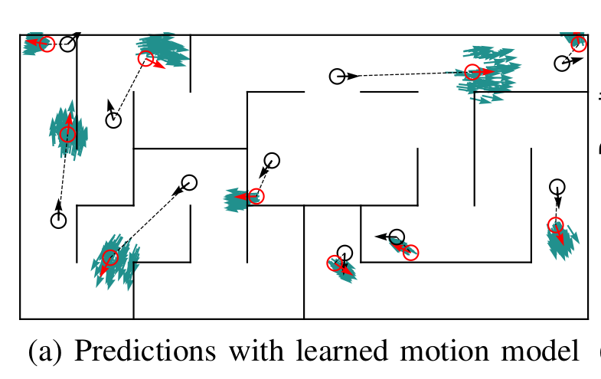
Motion Model Experiments
Black particle - previous state
Cyan particles - prediction of current state
Red particle - current true state
Notes:
So now we will start talking about experimental results provided in the paper. First, we will talk about motion model experiments. In this figure, black particle represents previous state. Cyan particles are prediction of the model for current state and red particle is current true state so predicted particles look very close to current true state.

Slide 8
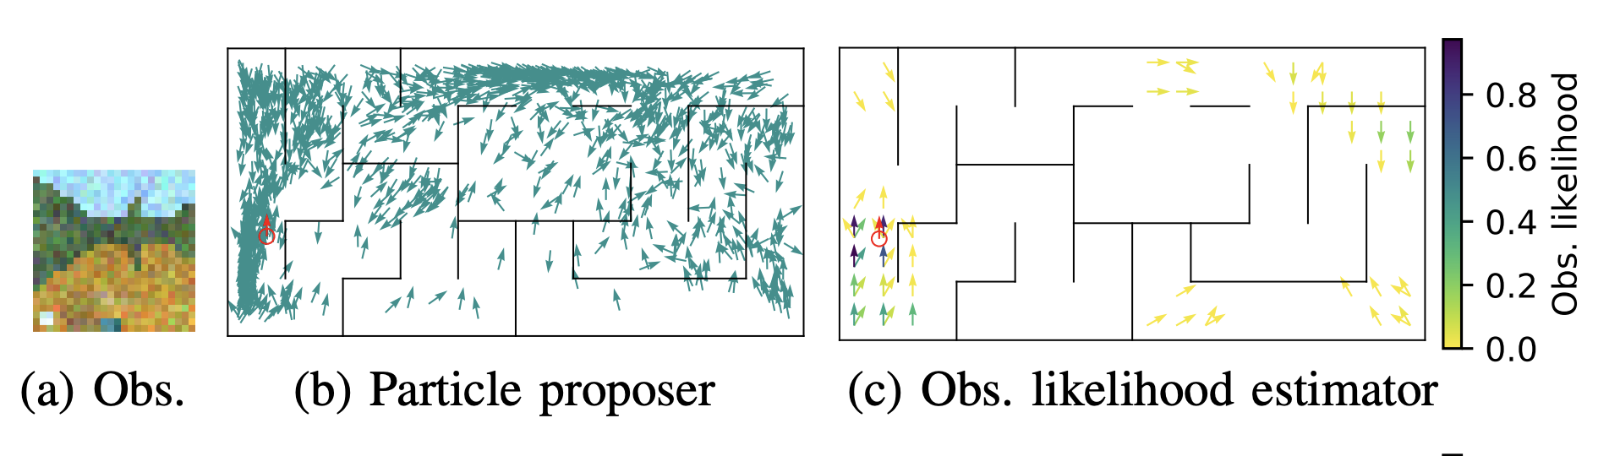
Simulated Experiment
Notes:
In the paper they train and evaluate the differentiable particle filter on two separate tasks
The first uses a simulated maze, figure a is an example observation of the maze, figure b is the initial particle proposer at an early timestep and figure c shows the observation likelihoods corresponding to figure b
For each maze a 1000 trajectories of 100 steps were collected with one step per second for training and testing

Slide 9
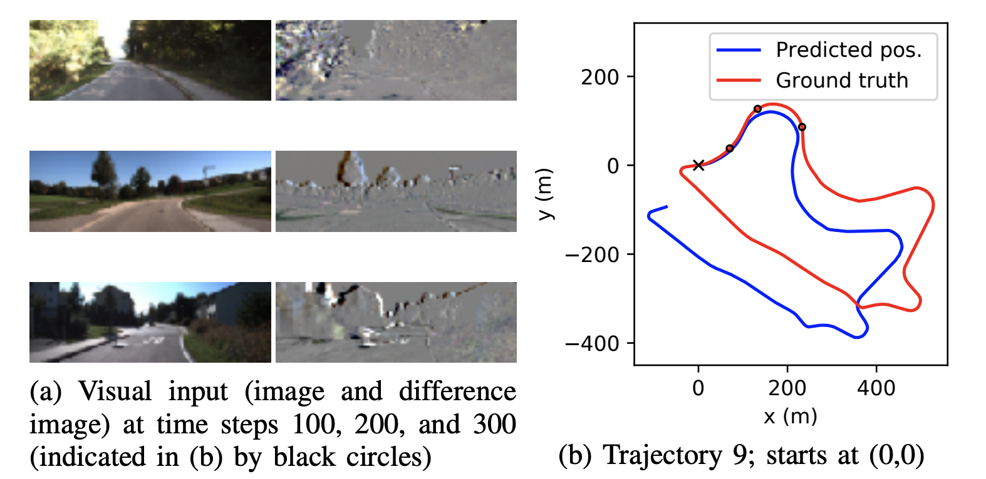
KITTI Experiment
Notes:
The Differentiable Particle Filter was also applied to the KITTI Visual Odometry Dataset.
The goal of the task is to track the pose of a driving car based on a first-person-view video
The dataset consists of 11 trajectories of a real car driving in an urban area for a total of 40 minutes.
The challenge of this task is to generalize in a way that works across highly diverse observations because the method is tested on roads that are never seen during training.
Since it is not possible to extract global information about the car’s position from the images. Instead, the translational and angular velocity of the car are estimated from the stream of images and integrated over time to track the car’s position and orientation
DPFs learn to perform visual odometry from a known initial state using a simple first-order dynamics model and a learnable action sampler.
Overall, the results demonstrate that DPFs generalize to different tasks and can be successfully applied to real data

Slide 10
Challenges
Challenges:
Matching camera and pose timesteps
Amount of data needed for training
Training on real world data
No baseline to compare to
Notes:
And so, while we have been working on applying the differentiable particle filter to multiple floors of GDC we have encountered several challenges.
To begin, once we were able to enable the cameras and began recording video and pose information, we then had to find a way to match each frame to its corresponding pose, this was due to the sensors being out of synch.
Secondly, the original paper collects approximately 27 hours worth of data for each maze, we are choosing to collect a smaller amount.
additionally, the paper never attempts to apply the differentiable particle filter to a real-life localization problem. Therefor it is uncertain how well it will generalize to real-world data.
Incidentally, we have no baseline to compare are results to besides our assignment #2

Slide 11
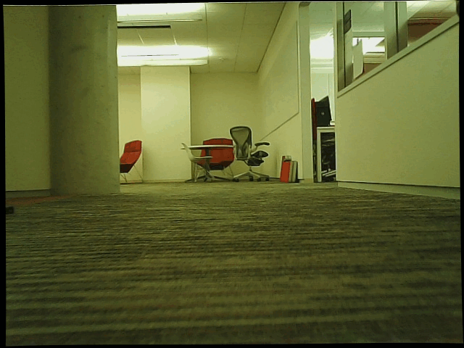
Notes:
So just to show some intermediate progress, we are currently working on collecting the data for training.
This is an example of a trajectory used in training, in the paper each time step is one second apart however, in the interest of time we have been recording each time step at a rate of half a second.
Each frame has corresponding pose which we acquire using the localization topic in ROS
The images shown here are before our preprocessing step, we resize each frame to a 32 x32 and then randomly crop these images to be 24x24, lastly we add gaussian noise to the images only
We also modified the original authors code to accept the format our data is in.

